Slide 1
My SQL Project
Shakila movie Database

Slide 2
Project objective
The objective of the project is to use My SQL to analyse the data of a movie rental store for further growth and improved business .

Slide 3
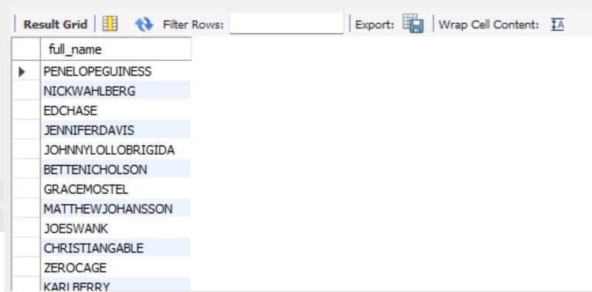
Task 1
Display the full names of actors available in the database.
Code : select concat (first name ,‘’, last-named) as full name from actor;

Slide 4
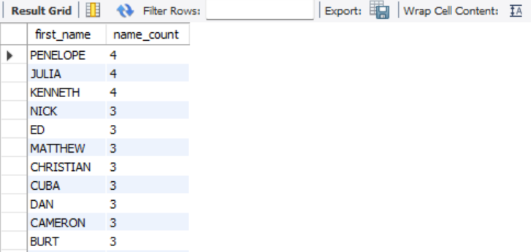
Task 2
Management want to know if there are any names of the actors appearing frequently.
Display the number of times each first name appears in the database.
Code : select first name ,count(*) as name count from actor
group by first name order by name count desc;

Slide 5
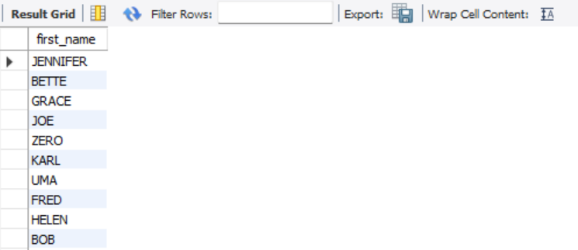
What is the count of actors that have unique first names in the database? Display the first names of all these actors.
Code : select first name from actor
group by first name having count(*) =1;

Slide 6
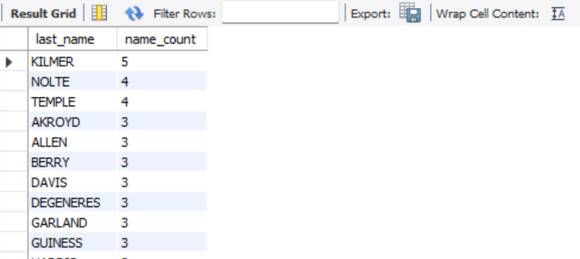
Task 3
The management is interested to analyze the similarity in the last names of the actors.
Display the number of times each last name appears in the database.
Code : select last name, COUNT(*) as name count from actor
group by last-named order by name count desc;

Slide 7
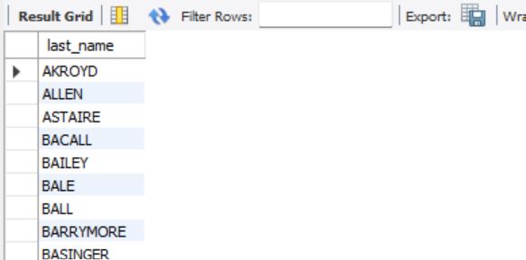
Display all unique last names in the database
Code : SELECT DISTINCT last name FROM actor;

Slide 8
Task 4
The management wants to analyze the movies based on their ratings to determine if they are suitable for kids-- or some parental assistance is required. Perform the following tasks to perform the required analysis.
Display the list of records for the movies with the rating "R". (The movies with the rating "R" are not suitable for audience under 17 years of age).

Slide 9

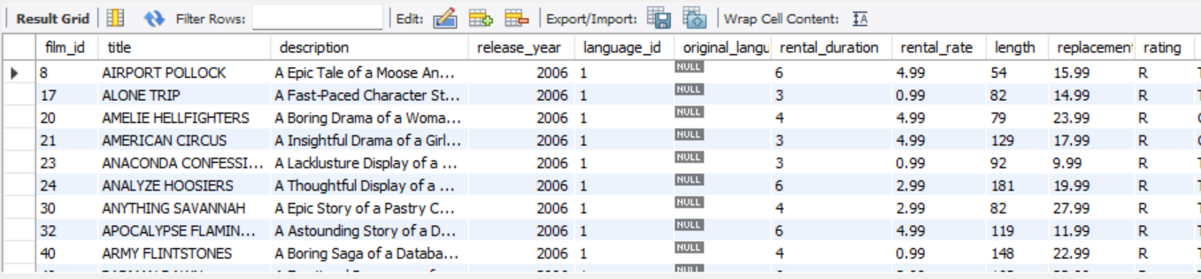
Code :
select * from film where rating = 'R’;
select count(*) from film where rating = 'R';

Slide 10
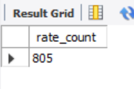
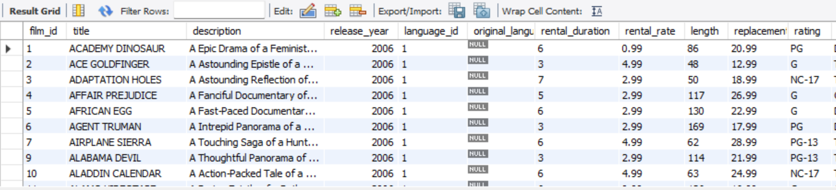
Display the list of records for the movies that are not rated "R".
Code: select * from film where rating != 'R’;
select count(*) from film where rating != 'R';

Slide 11
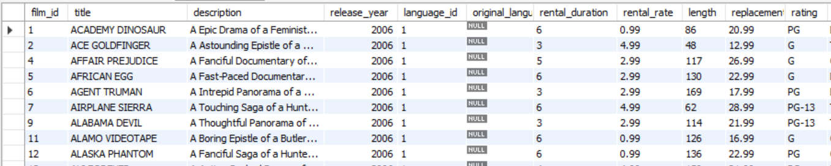
Display the list of records for the movies that are suitable for audience below 13 years of age.
Code : SELECT *FROM film WHERE rating = 'G' OR rating = 'PG' OR rating = 'PG-13’;
SELECT count(*)FROM film WHERE rating = 'G' OR rating = 'PG' OR rating = 'PG-13';

Slide 12
Task 5
The board members want to understand the replacement cost of a movie copy(disc - DVD/Blue Ray). The replacement cost refers to the amount charged to the customer if the movie disc is not returned or is returned in a damaged state.
Display the list of records for the movies where the replacement cost is up to $11.
Code : SELECT *FROM film WHERE replacement cost <= 11;
Display the list of records for the movies where the replacement cost is between $11 and $20.
Code : SELECT *FROM film WHERE replacement cost > 11 AND replacement cost <= 20;

Slide 13
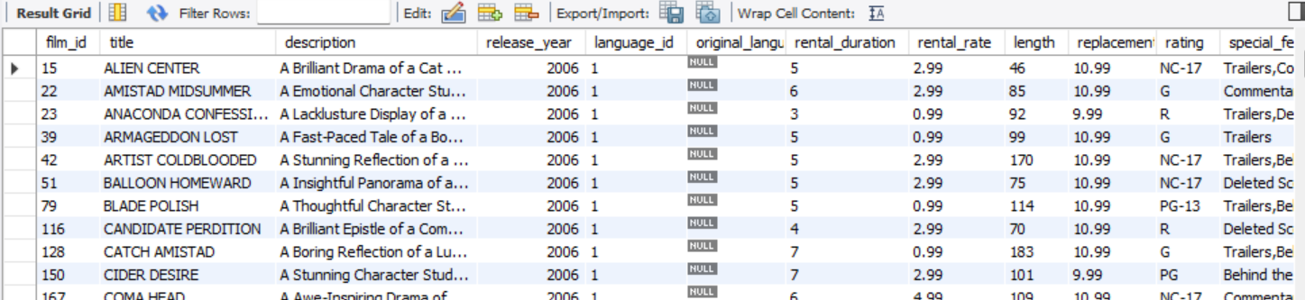
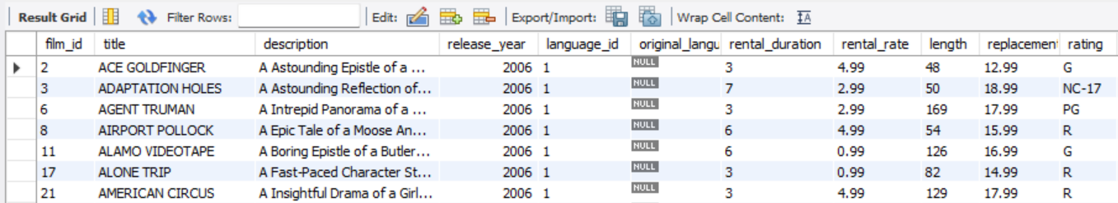

Slide 14
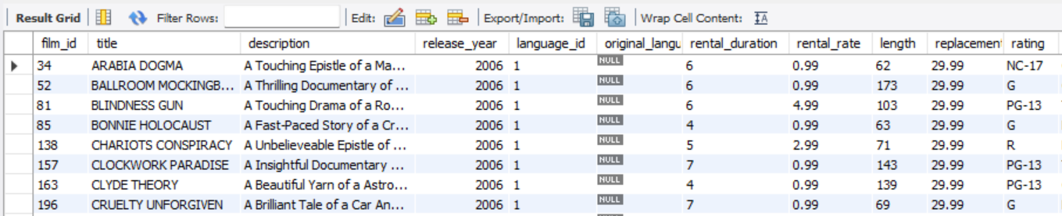
Display the list of records for the all movies in descending order of their replacement costs.
Code :
select * from film order by replacement cost desc;

Slide 15
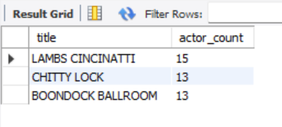
Task 6
Display the names of the top 3 movies with the greatest number of actors.
Code:
SELECT film. Title, COUNT(film _ actor . Actor _ id) AS actor count FROM film
INNER JOIN film _ actor ON film . film _ id = film _ actor .film _ id
GROUP BY film . title ORDER BY actor count DESCLIMIT 3;

Slide 16
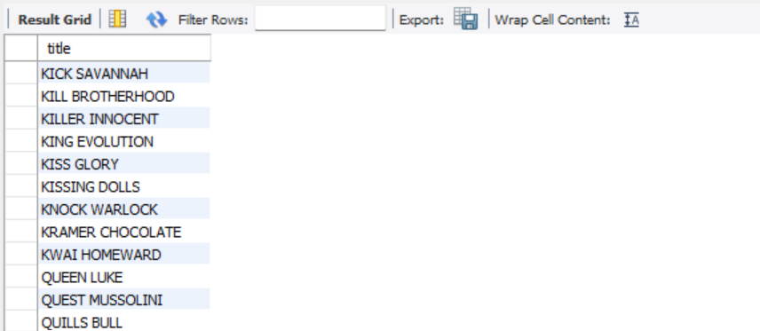
Task 7
'Music of Queen' and 'Kris Kristofferson' have seen an unlikely resurgence. As an unintended consequence, films starting with the letters 'K' and 'Q' have also soared in popularity.
Display the titles of the movies starting with the letters 'K' and 'Q’.
Code :
SELECT title FROM film WHERE title LIKE 'K%' OR title LIKE 'Q%'ORDER BY title;

Slide 17
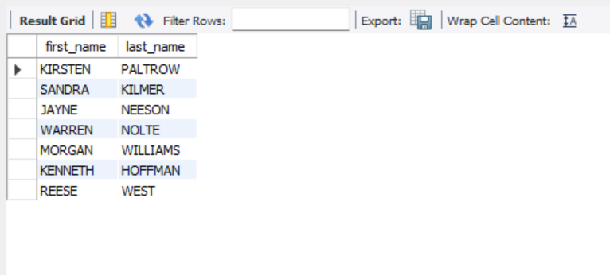
Task 8
The film 'Agent Truman' has been a great success. Display the names of all actors who appeared in this film.
Code :
SELECT actor .first _ name, actor . last-name FROM actor
INNER JOIN film _ actor ON actor . Actor _ id = film _ actor .actor _ id
INNER JOIN film ON film _ actor. film _ id = film . film _ id WHERE film . title = 'Agent Truman';

Slide 18
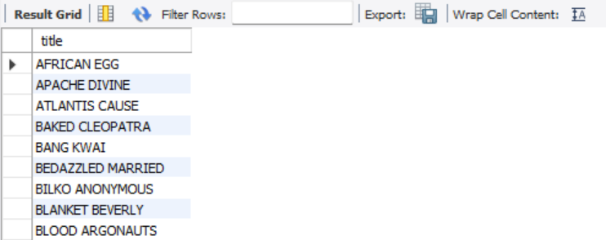
Task 9
Sales have been lagging among young families, so the management wants to promote family movies. Identify all the movies categorized as family films.
Code :
SELECT film. Title FROM film
INNER JOIN film category ON film . Film _id = film _ category. film_ id
INNER JOIN category ON film _ category . category _ id = category . category _ id WHERE category.name = 'Family';

Slide 19
Task 10
The management wants to observe the rental rates and rental frequencies (Number of time the movie disc is rented).
Display the maximum, minimum, and average rental rates of movies based on their ratings. The output must be sorted in descending order of the average rental rates.
Code :
SELECT rating, MAX(rental rate) AS max _ rental rate, MIN(rental rate) AS min _ rental rate, AVG(rental rate) AS avg _rental rate FROM film GROUP BY rating ORDER BY avg _rental rate DESC;

Slide 20
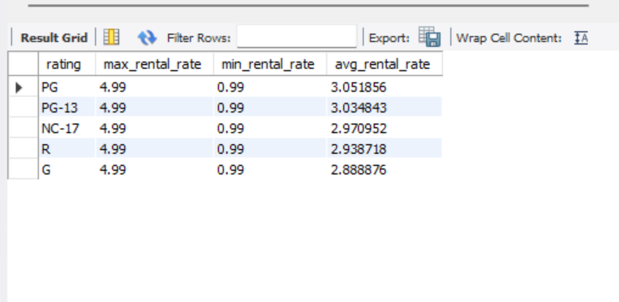

Slide 21
Display the movies in descending order of their rental frequencies, so the management can maintain more copies of those movies.
Code :
SELECT f. film _ id, f . title, COUNT(r . Rental _ id) AS rental count FROM films AS f
LEFT JOIN inventory AS i ON f . film_ id = I .film _ id
LEFT JOIN rental AS r ON I .inventory id = r . Inventory id
GROUP BY f . film id, f. title ORDER BY rental count DESC;

Slide 22
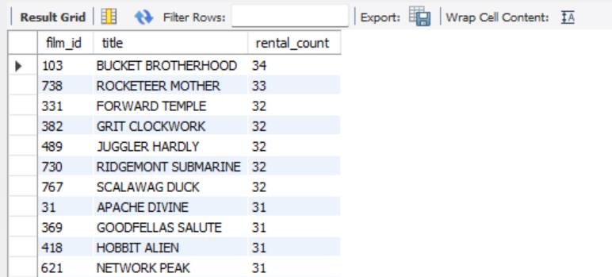

Slide 23
Task 11
In how many film categories, the difference between the average film replacement cost ((disc-DVD/Blue Ray) and the average film rental rate is greater than $15?-- Display the list of all film categories identified above, along with the corresponding average film replacement cost and average film rental rate.
Code :
SELECT category.name AS category name, AVG(film . replacement cost) AS avg _ replacement cost, AVG(film . Rental rate) AS avg rental rate FROM category
JOIN film category ON category. Category id = film category. Category id
JOIN film ON film category .film id = film . Film id
GROUP BY category name
HAVING (AVG(film .replacement cost) - AVG(film .rental rate)) > 15;

Slide 24
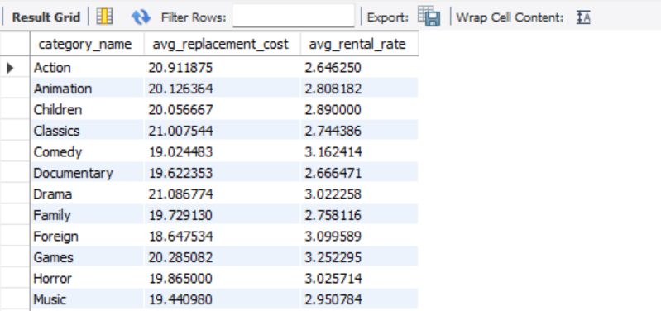

Slide 25
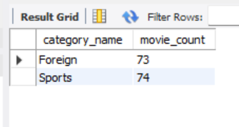
Task 12
Display the film categories in which the number of movies is greater than 70.
Code :
SELECT category.name AS category name, COUNT(film . film id) AS movie count FROM category
INNER JOIN film category ON category. Category id = film category .category id
INNER JOIN film ON film category .film id = film . film id
GROUP BY category name
HAVING movie count > 70;

Slide 26


